Slide 1
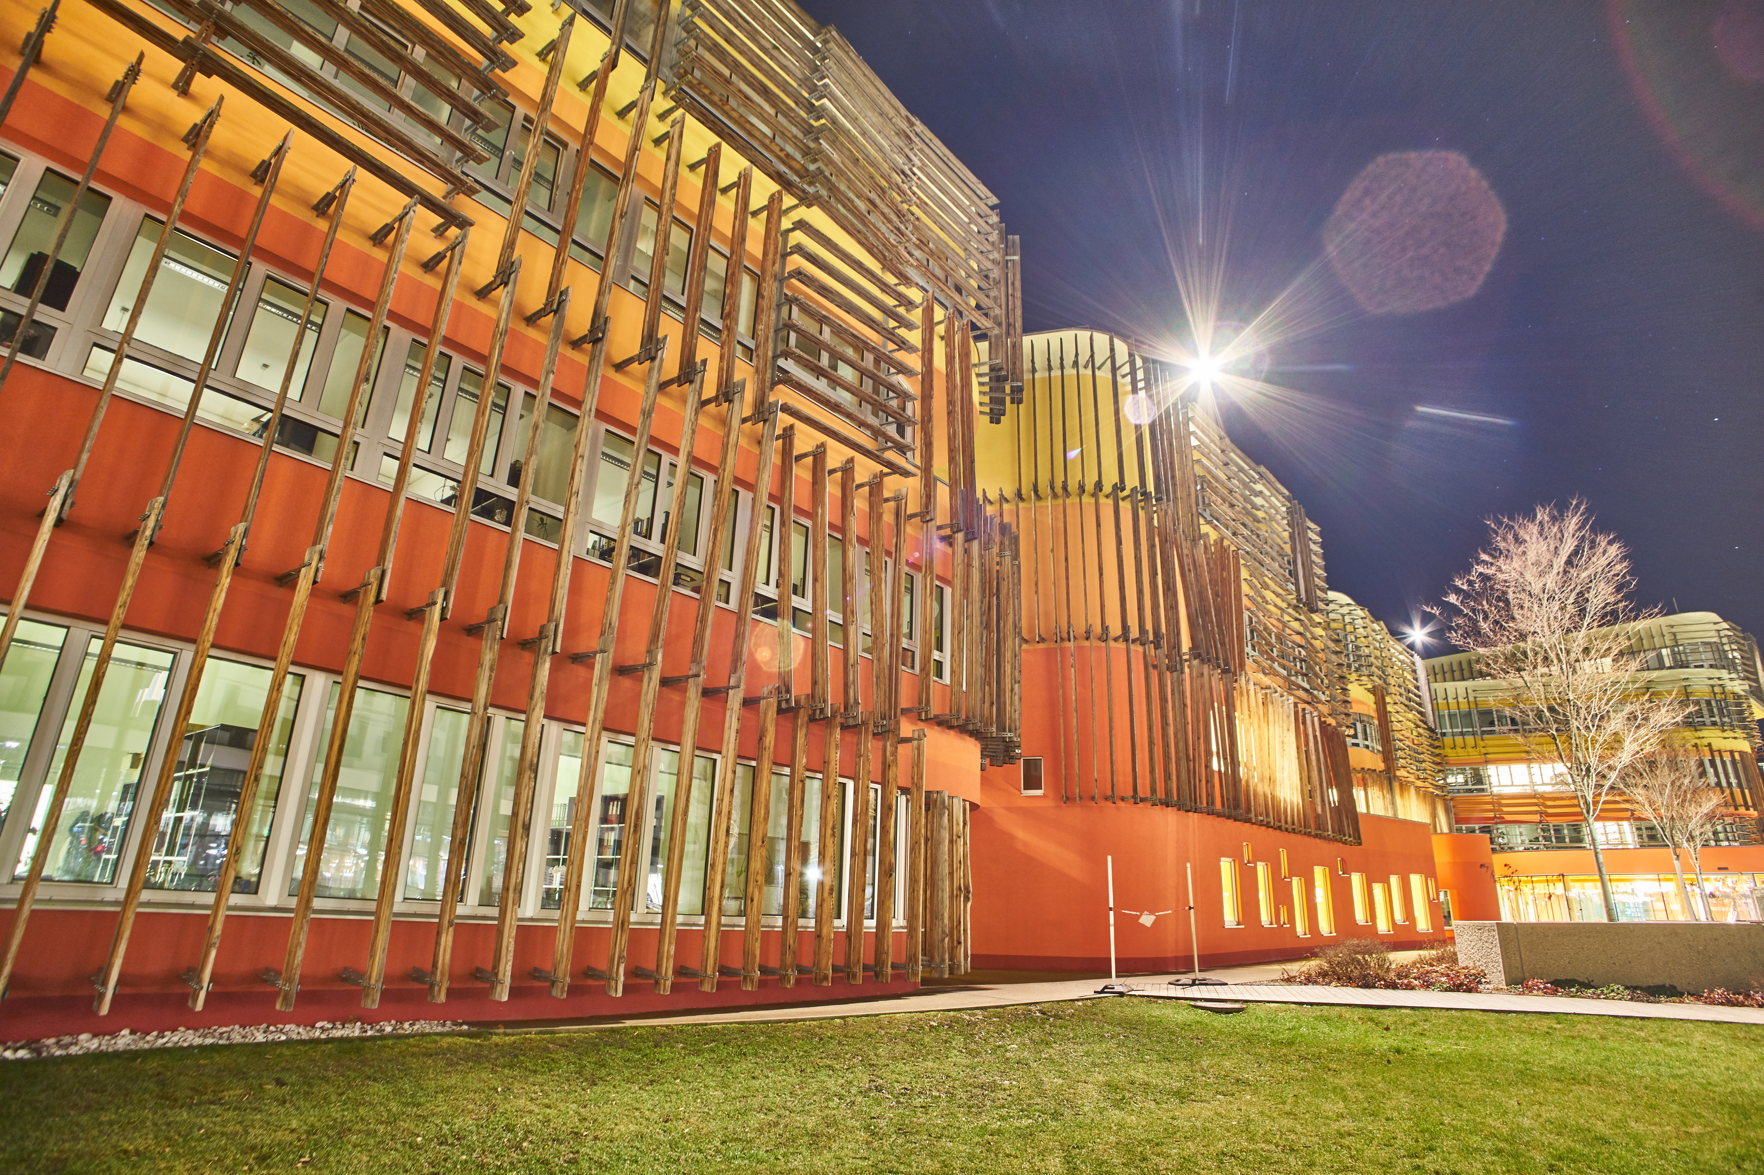
Principles of Software Programming: Introduction
Anton Yeshchenko
SS 2018
March 2018.

Slide 2
Preview
Programming
Algorithm
First application demo!
How hardware works
How software works
End.

Slide 3
What is Programming?
https://pixabay.com/en/photos/computer%20science/
slide borrowed from Svitlana Vakulenko WS 2017 lecture slides
Notes:
Design a plan to solve a problemComputers only do what they are told to doDemanding, intellectual activitySoftware consists of data and commands: Data = Elements, which are processed by the program (eg numbers, texts)Commands: what is done with the data (eg add numbers, print text) Programming means designing a plan to solve a problem so completely and in detail that not only a human but also a computer can execute it. Computers are simple-minded, they just do what they are told to do, and follow these commands exactly. Computers can only handle a limited set of data and commands, yet almost infinitely complex applications can be assembled. Demanding, intellectual activity, similar to writers, anyone can write, but few can do well. Professional Goal IT Management - even if you do not program later, you have to understand how software works, how to lead programming teams, and how to evaluate software. A program consists of data (elements processed by program - e.g., numbers, text, images, videos) and commands (are operations performed on the data - e.g., adding numbers, printing images, etc.)

Slide 4
What is Programming?
https://de.wikipedia.org/wiki/Architekt
https://commons.wikimedia.org/wiki/File:Art_in_dress_(1922)_(14781442712).jpg
slide borrowed from Svitlana Vakulenko WS 2017 lecture slides
Notes:
Plan zur Lösung eines Problems entwerfen
Computer tun ausschließlich das, was man ihnen ausdrücklich befiehlt
Anspruchsvolle, intellektuelle Tätigkeit
Software besteht aus Daten und Befehlen: Daten = Elements, die vom Programm verarbeitet werden (zB Zahlen, Texte)
Befehle: was wird mit den Daten getan (zB Zahlen addieren, Text drucken)
Programmieren bedeutet, einen Plan zur Lösung eines Problems zu entwerfen, und zwar so vollständig und detailliert, dass ihn nicht nur ein Mensch, sondern auch ein Computer ausführen kann.
Computer sind einfältig, sie tun nur das, was man ihnen ausdrücklich sagt, und befolgen diese Befehle auf Punkt und Komma genau.
Computer beherrschen nur begrenzten Satz an Daten und Befehlen, trotzdem fast unbegrenzt komplexe Anwendungen zusammenbaubar.
Anspruchsvolle, intellektuelle Tätigkeit, ähnlich Schriftsteller, jeder kann schreiben, aber nur wenige können es gut.
Berufsziel IT-Management – auch wenn man später nicht programmiert, muss man verstehen, wie Software arbeitet, zum Leiten von Programmierteams und Beurteilen von Software.
Ein Programm besteht aus Daten (Elemente, die von Programm verarbeitet werden – z.B. Zahlen, Texte, Bilder, Videos) und Befehle (sind Operationen, die mit den Daten ausgeführt werden - z.B: Zahlen addieren, Bilder drucken usw.)

Slide 5
What is Programming?
Idea: describe a solution to the problem in a precise manner, so that computer can follow the commands
☞ Problem
☞ Creative solution
Data Inputs + Program(Commands) => Results
slide borrowed from Svitlana Vakulenko WS 2017 lecture slides
Notes:
Plan zur Lösung eines Problems entwerfen
Computer tun ausschließlich das, was man ihnen ausdrücklich befiehlt
Anspruchsvolle, intellektuelle Tätigkeit
Software besteht aus Daten und Befehlen: Daten = Elements, die vom Programm verarbeitet werden (zB Zahlen, Texte)
Befehle: was wird mit den Daten getan (zB Zahlen addieren, Text drucken)
Programmieren bedeutet, einen Plan zur Lösung eines Problems zu entwerfen, und zwar so vollständig und detailliert, dass ihn nicht nur ein Mensch, sondern auch ein Computer ausführen kann.
Computer sind einfältig, sie tun nur das, was man ihnen ausdrücklich sagt, und befolgen diese Befehle auf Punkt und Komma genau.
Computer beherrschen nur begrenzten Satz an Daten und Befehlen, trotzdem fast unbegrenzt komplexe Anwendungen zusammenbaubar.
Anspruchsvolle, intellektuelle Tätigkeit, ähnlich Schriftsteller, jeder kann schreiben, aber nur wenige können es gut.
Berufsziel IT-Management – auch wenn man später nicht programmiert, muss man verstehen, wie Software arbeitet, zum Leiten von Programmierteams und Beurteilen von Software.
Ein Programm besteht aus Daten (Elemente, die von Programm verarbeitet werden – z.B. Zahlen, Texte, Bilder, Videos) und Befehle (sind Operationen, die mit den Daten ausgeführt werden - z.B: Zahlen addieren, Bilder drucken usw.)

Slide 6
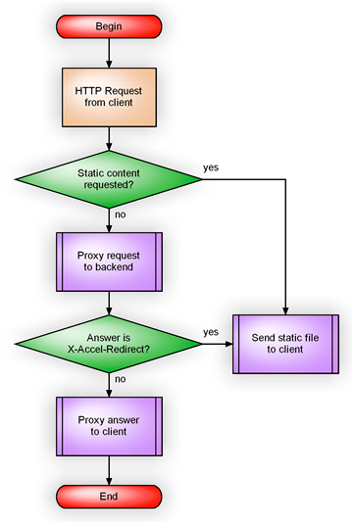
Algorithm
Sequence of commands (computation steps)
slide borrowed from Svitlana Vakulenko WS 2017 lecture slides
Notes:
Ein Algorithmus ist noch kein Programm.
In der Informatik stellen wir an Algorithmen jedoch die Forderung, dass sie schrittweise und präzise sein müssen.
Schrittweise bedeutet, dass ein Algorithmus aus einzelnen Schritten besteht, die in genau festgelegter Reihenfolge ausgeführt werden müssen.
Kein noch so nebensächlicher Schritt darf unerwähnt bleiben, Rechner kann nicht mitdenken.

Slide 7

Examples of Algorithms
Recipe for coffee, is an algorithm
http://2.bp.blogspot.com/-bPE0E6zEHkg/T4bGyQaMSlI/AAAAAAAAoA0/cPDOpjpt9AY/s1600/20120402_Demel-Coffee-Einsp%25C3%25A4nner-Copyright-Merisi-Vienna_0218.jpg
https://www.epicurious.com/recipes/food/views/einspanner-200826
Notes:
Jedem Programm liegen Algorithmen zugrunde, sie können auch in Umgangssprache beschrieben werden - Kochrezept ist z.B. ein Algorithmus zur Zubereitung eines Gerichts. Wegbeschreibung ist ein Algorithmus, wie man von einem Ort zum nächsten kommt.

Slide 8
Examples of Algorithms
EINSPANNER
Coffee:
60 ml (2 shots) espresso
cocoa powder to top
brown sugar as preferred
Whipped cream:
100 to 120 ml heavy/whipping cream (aka 35% cream)
1.5 tsp powdered sugar
1/2 tsp vanilla extract (optional)
Instructions:
Whip the heavy cream until stiff with peaks by hand or using a mixer with the whisk attachment. Add freshly brewed espresso into a cup and top with whipped cream. The ratio of cream to espresso for an Einspanner is 1:1 so not all the cream will be used up—although I certainly won’t discourage you from adding all the of the whipped cream into the drink! To finish, sift on cocoa powder and add brown sugar to your liking.
http://2.bp.blogspot.com/-bPE0E6zEHkg/T4bGyQaMSlI/AAAAAAAAoA0/cPDOpjpt9AY/s1600/20120402_Demel-Coffee-Einsp%25C3%25A4nner-Copyright-Merisi-Vienna_0218.jpg
https://www.epicurious.com/recipes/food/views/einspanner-200826
Notes:
Jedem Programm liegen Algorithmen zugrunde, sie können auch in Umgangssprache beschrieben werden - Kochrezept ist z.B. ein Algorithmus zur Zubereitung eines Gerichts. Wegbeschreibung ist ein Algorithmus, wie man von einem Ort zum nächsten kommt.

Slide 9
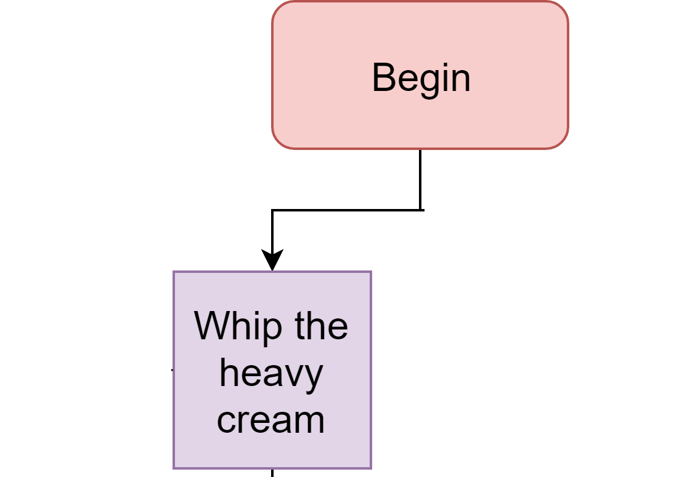
Examples of Algorithms
EINSPANNER
Instructions:
Whip the heavy cream until stiff with peaks by hand or using a mixer with the whisk attachment. Add freshly brewed espresso into a cup and top with whipped cream. The ratio of cream to espresso for an Einspanner is 1:1 so not all the cream will be used up—although I certainly won’t discourage you from adding all the of the whipped cream into the drink! To finish, sift on cocoa powder and add brown sugar to your liking.
http://2.bp.blogspot.com/-bPE0E6zEHkg/T4bGyQaMSlI/AAAAAAAAoA0/cPDOpjpt9AY/s1600/20120402_Demel-Coffee-Einsp%25C3%25A4nner-Copyright-Merisi-Vienna_0218.jpg
https://www.epicurious.com/recipes/food/views/einspanner-200826
Notes:
Jedem Programm liegen Algorithmen zugrunde, sie können auch in Umgangssprache beschrieben werden - Kochrezept ist z.B. ein Algorithmus zur Zubereitung eines Gerichts. Wegbeschreibung ist ein Algorithmus, wie man von einem Ort zum nächsten kommt.

Slide 10
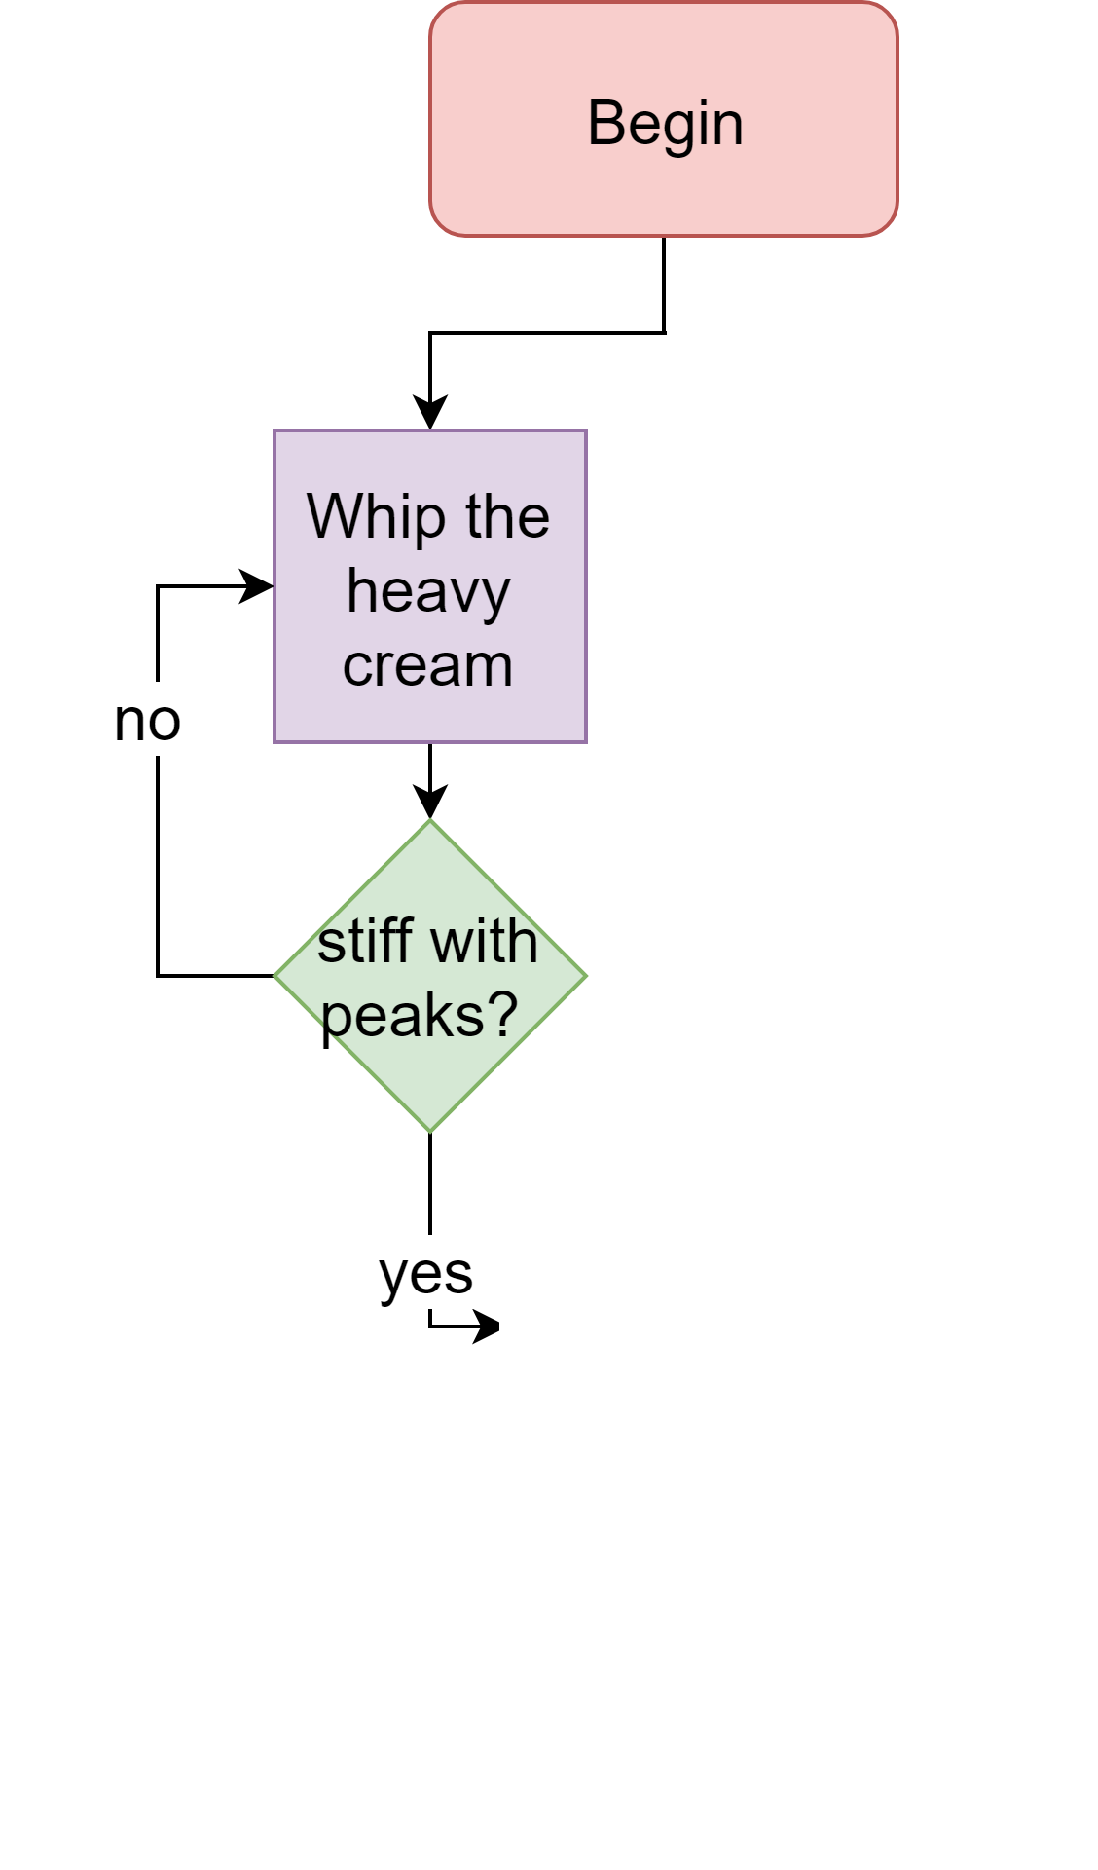
Examples of Algorithms
EINSPANNER
Instructions:
Whip the heavy cream until stiff with peaks by hand or using a mixer with the whisk attachment. Add freshly brewed espresso into a cup and top with whipped cream. The ratio of cream to espresso for an Einspanner is 1:1 so not all the cream will be used up—although I certainly won’t discourage you from adding all the of the whipped cream into the drink! To finish, sift on cocoa powder and add brown sugar to your liking.
http://2.bp.blogspot.com/-bPE0E6zEHkg/T4bGyQaMSlI/AAAAAAAAoA0/cPDOpjpt9AY/s1600/20120402_Demel-Coffee-Einsp%25C3%25A4nner-Copyright-Merisi-Vienna_0218.jpg
https://www.epicurious.com/recipes/food/views/einspanner-200826
Notes:
Jedem Programm liegen Algorithmen zugrunde, sie können auch in Umgangssprache beschrieben werden - Kochrezept ist z.B. ein Algorithmus zur Zubereitung eines Gerichts. Wegbeschreibung ist ein Algorithmus, wie man von einem Ort zum nächsten kommt.

Slide 11
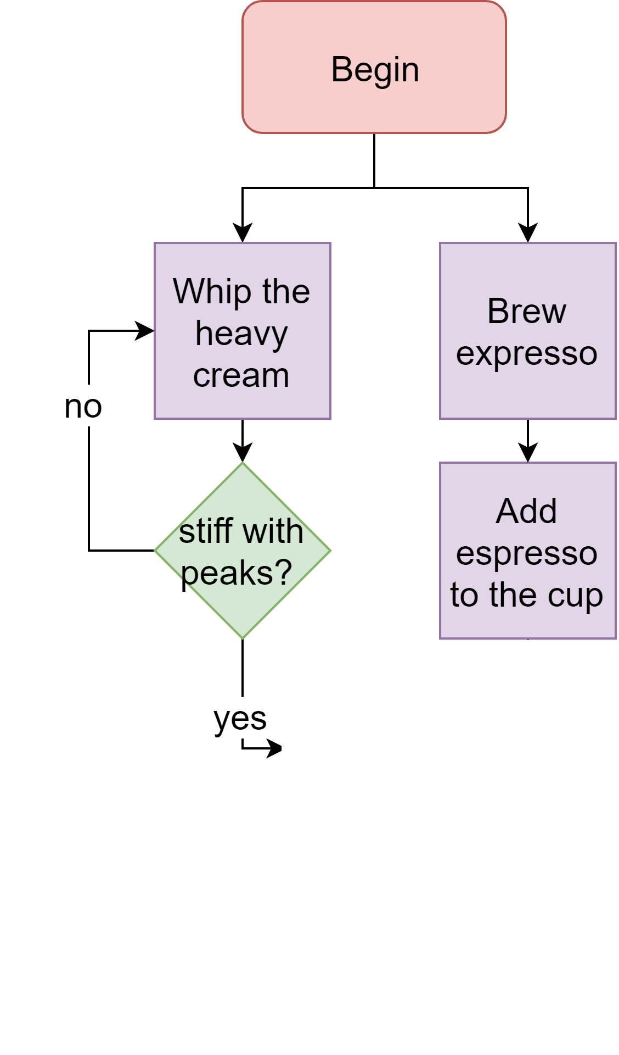
Examples of Algorithms
EINSPANNER
Instructions:
Whip the heavy cream until stiff with peaks by hand or using a mixer with the whisk attachment. Add freshly brewed espresso into a cup and top with whipped cream. The ratio of cream to espresso for an Einspanner is 1:1 so not all the cream will be used up—although I certainly won’t discourage you from adding all the of the whipped cream into the drink! To finish, sift on cocoa powder and add brown sugar to your liking.
http://2.bp.blogspot.com/-bPE0E6zEHkg/T4bGyQaMSlI/AAAAAAAAoA0/cPDOpjpt9AY/s1600/20120402_Demel-Coffee-Einsp%25C3%25A4nner-Copyright-Merisi-Vienna_0218.jpg
https://www.epicurious.com/recipes/food/views/einspanner-200826
Notes:
Jedem Programm liegen Algorithmen zugrunde, sie können auch in Umgangssprache beschrieben werden - Kochrezept ist z.B. ein Algorithmus zur Zubereitung eines Gerichts. Wegbeschreibung ist ein Algorithmus, wie man von einem Ort zum nächsten kommt.

Slide 12
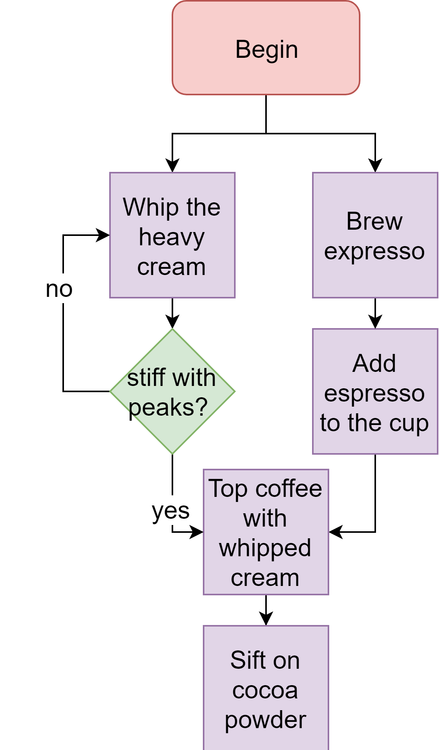
Examples of Algorithms
EINSPANNER
Instructions:
Whip the heavy cream until stiff with peaks by hand or using a mixer with the whisk attachment. Add freshly brewed espresso into a cup and top with whipped cream. The ratio of cream to espresso for an Einspanner is 1:1 so not all the cream will be used up—although I certainly won’t discourage you from adding all the of the whipped cream into the drink! To finish, sift on cocoa powder and add brown sugar to your liking.
http://2.bp.blogspot.com/-bPE0E6zEHkg/T4bGyQaMSlI/AAAAAAAAoA0/cPDOpjpt9AY/s1600/20120402_Demel-Coffee-Einsp%25C3%25A4nner-Copyright-Merisi-Vienna_0218.jpg
https://www.epicurious.com/recipes/food/views/einspanner-200826
Notes:
Jedem Programm liegen Algorithmen zugrunde, sie können auch in Umgangssprache beschrieben werden - Kochrezept ist z.B. ein Algorithmus zur Zubereitung eines Gerichts. Wegbeschreibung ist ein Algorithmus, wie man von einem Ort zum nächsten kommt.

Slide 13
Examples of Algorithms
EINSPANNER
Instructions:
Whip the heavy cream until stiff with peaks by hand or using a mixer with the whisk attachment. Add freshly brewed espresso into a cup and top with whipped cream. The ratio of cream to espresso for an Einspanner is 1:1 so not all the cream will be used up—although I certainly won’t discourage you from adding all the of the whipped cream into the drink! To finish, sift on cocoa powder and add brown sugar to your liking.
http://2.bp.blogspot.com/-bPE0E6zEHkg/T4bGyQaMSlI/AAAAAAAAoA0/cPDOpjpt9AY/s1600/20120402_Demel-Coffee-Einsp%25C3%25A4nner-Copyright-Merisi-Vienna_0218.jpg
https://www.epicurious.com/recipes/food/views/einspanner-200826
Notes:
Jedem Programm liegen Algorithmen zugrunde, sie können auch in Umgangssprache beschrieben werden - Kochrezept ist z.B. ein Algorithmus zur Zubereitung eines Gerichts. Wegbeschreibung ist ein Algorithmus, wie man von einem Ort zum nächsten kommt.

Slide 14
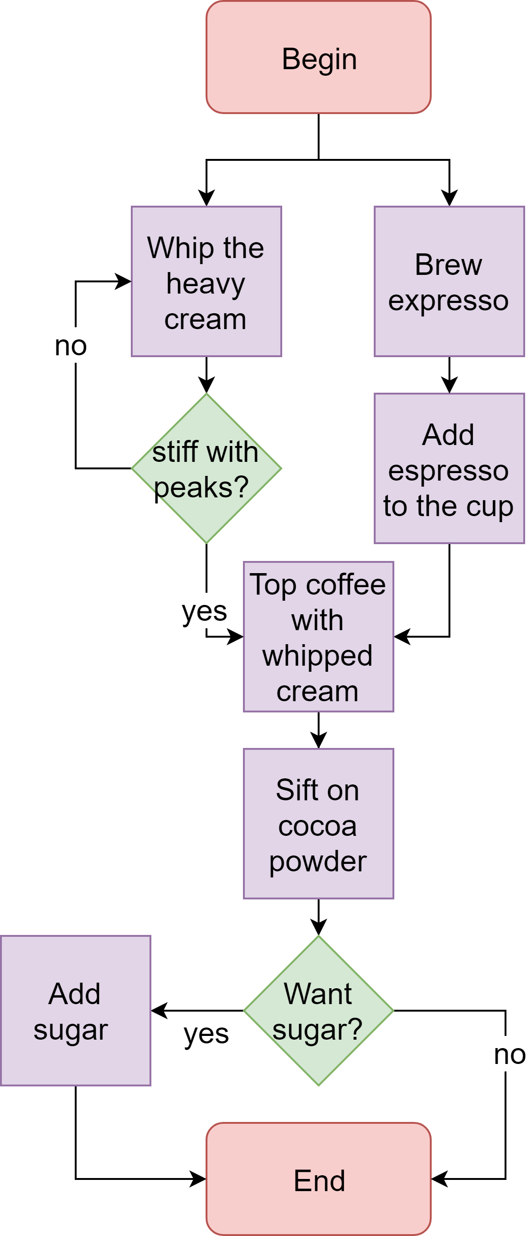
Examples of Algorithms
EINSPANNER
Instructions:
Whip the heavy cream until stiff with peaks by hand or using a mixer with the whisk attachment. Add freshly brewed espresso into a cup and top with whipped cream. The ratio of cream to espresso for an Einspanner is 1:1 so not all the cream will be used up—although I certainly won’t discourage you from adding all the of the whipped cream into the drink! To finish, sift on cocoa powder and add brown sugar to your liking.
http://2.bp.blogspot.com/-bPE0E6zEHkg/T4bGyQaMSlI/AAAAAAAAoA0/cPDOpjpt9AY/s1600/20120402_Demel-Coffee-Einsp%25C3%25A4nner-Copyright-Merisi-Vienna_0218.jpg
https://www.epicurious.com/recipes/food/views/einspanner-200826
Notes:
Jedem Programm liegen Algorithmen zugrunde, sie können auch in Umgangssprache beschrieben werden - Kochrezept ist z.B. ein Algorithmus zur Zubereitung eines Gerichts. Wegbeschreibung ist ein Algorithmus, wie man von einem Ort zum nächsten kommt.

Slide 15
Examples of Algorithms
Big Bang Theory: “The Friendship Algorithm”:
http://www.youtube.com/watch?v=k0xgjUhEG3U
Notes:
Jedem Programm liegen Algorithmen zugrunde, sie können auch in Umgangssprache beschrieben werden - Kochrezept ist z.B. ein Algorithmus zur Zubereitung eines Gerichts. Wegbeschreibung ist ein Algorithmus, wie man von einem Ort zum nächsten kommt.

Slide 16



Languages
Natural language is complex and ambiguous
Programming language is simple and straight-forward
http://noeticforce.com/most-popular-programming-languages-best-for-developers
Notes:
z.B. wenn sie Kollegen sagen „ den Rest kannst du löschen“, dann versteht er es, da er den Kontext kennt.

Slide 17

First Demo!
Notes:
Here I show the demo with command line and file for the application “Hello world”

Slide 18
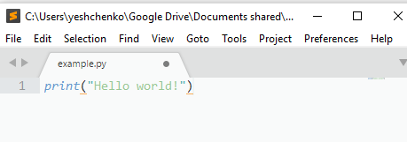

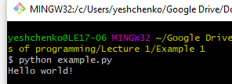
What’s under the hood? (Long story)
Program executed (run)

Slide 19
What’s under the hood?
Software
Hardware

Slide 20
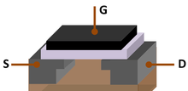
(1)The Physical Level
transistor
it's an electronic switch, essentially
Notes:
START DRAWING DIAGRAM ON THE SIDE SCREEN!
he Physical Level
In terms of physical phenomena, it all just boils down to voltages [1]. In the field of electronic circuits, there's a particular handy device called a "transistor" that basically allows you to control voltages by means of other voltages— it's an electronic switch, essentially.
Transistors[2] have three "terminals" that you can attach wires to, labeled "G", "S", and "D". If you apply a high voltage to the "G" terminal, the "S" and "D" terminals are electrically connected together and allow electric current to flow through. But if the "G" terminal has a low voltage, the "S" and "D" terminals are electrically disconnected [3]. It should be simple to imagine that, using this "transistor" device, you can build a circuit that uses voltages to manipulate other voltages. You can do this by systematically selecting parts of the circuit to connect or disconnect from each other by using transistors, which causes changes in voltage that affect other transistors, and so on.
[1] I hope you paid attention in whatever introductory EM physics class you took, if any. But on the off chance that you didn't take such a class, or you fell asleep in it, a "voltage" (is the difference in electric potential between two points)is really just a particular way of measuring electrical potential energy that results from placing an electrical charge in a particular location in an electric field. A "high voltage" means that there is high electrical potential energy per unit of electric charge. If you still have no idea what I'm talking about, just think of "high voltage" as very roughly meaning "high energy"!
[2] Specifically in the example I give here, we're talking about a particular type of transistor called a "MOSFET".
[3] This is an enormous oversimplification of the physical equations that describe how MOSFETs actually work, but the "voltage switch" idea is a useful one for conceptualizing how we build circuits that take advantage of these things

Slide 21


(1)Logical NOT
input
output
Notes:
Now for the next layer of abstraction. At the most basic level in a computer (or any other digital device, really), we can "pretend" that something carrying a high voltage should represent the idea of "truth", and something carrying a low voltage should represent the idea of "falsehood". We can use those transistor circuits we built in the prior "physical" level to create devices called "logic gates". These are just physical devices that represent the ideas of "logical AND", "logical OR", and "logical NOT"— equivalent to what you'd find in basic mathematical logic, except now in physical form (being made out of transistors) rather than just existing on paper in the form of a logic equation.
VCC - battery
These are diagrams (that I stole from Wikipedia) of some possible ways we can construct logical AND, OR, and NOT gates using transistors. The double blue lines represent transistors, and the squiggly lines represent resistors. So, for instance, in the NOT device, if we apply a high voltage (“true”) to point a, that would cause point F to have a low voltage (“false”), and if we apply a low voltage (“false”) to point a, that would cause point F to have a high voltage (“true”). Essentially, this is logical NOT in circuit form.

Slide 22
(1)Numbers
High voltage -> Number 1
Low voltage -> Number 0

Slide 23
(1)Logical NOT
input 0
output 1
Notes:
Now for the next layer of abstraction. At the most basic level in a computer (or any other digital device, really), we can "pretend" that something carrying a high voltage should represent the idea of "truth", and something carrying a low voltage should represent the idea of "falsehood". We can use those transistor circuits we built in the prior "physical" level to create devices called "logic gates". These are just physical devices that represent the ideas of "logical AND", "logical OR", and "logical NOT"— equivalent to what you'd find in basic mathematical logic, except now in physical form (being made out of transistors) rather than just existing on paper in the form of a logic equation.
VCC - battery
These are diagrams (that I stole from Wikipedia) of some possible ways we can construct logical AND, OR, and NOT gates using transistors. The double blue lines represent transistors, and the squiggly lines represent resistors. So, for instance, in the NOT device, if we apply a high voltage (“true”) to point a, that would cause point F to have a low voltage (“false”), and if we apply a low voltage (“false”) to point a, that would cause point F to have a high voltage (“true”). Essentially, this is logical NOT in circuit form.

Slide 24
(1)Logical NOT
input 0
Input | Output
1 | 0
0 | 1
output 1
Notes:
Now for the next layer of abstraction. At the most basic level in a computer (or any other digital device, really), we can "pretend" that something carrying a high voltage should represent the idea of "truth", and something carrying a low voltage should represent the idea of "falsehood". We can use those transistor circuits we built in the prior "physical" level to create devices called "logic gates". These are just physical devices that represent the ideas of "logical AND", "logical OR", and "logical NOT"— equivalent to what you'd find in basic mathematical logic, except now in physical form (being made out of transistors) rather than just existing on paper in the form of a logic equation.
VCC - battery
These are diagrams (that I stole from Wikipedia) of some possible ways we can construct logical AND, OR, and NOT gates using transistors. The double blue lines represent transistors, and the squiggly lines represent resistors. So, for instance, in the NOT device, if we apply a high voltage (“true”) to point a, that would cause point F to have a low voltage (“false”), and if we apply a low voltage (“false”) to point a, that would cause point F to have a high voltage (“true”). Essentially, this is logical NOT in circuit form.

Slide 25
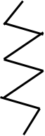
(1)Logical AND
Input A
Input B
Output
Notes:
Now for the next layer of abstraction. At the most basic level in a computer (or any other digital device, really), we can "pretend" that something carrying a high voltage should represent the idea of "truth", and something carrying a low voltage should represent the idea of "falsehood". We can use those transistor circuits we built in the prior "physical" level to create devices called "logic gates". These are just physical devices that represent the ideas of "logical AND", "logical OR", and "logical NOT"— equivalent to what you'd find in basic mathematical logic, except now in physical form (being made out of transistors) rather than just existing on paper in the form of a logic equation.
VCC - battery
These are diagrams (that I stole from Wikipedia) of some possible ways we can construct logical AND, OR, and NOT gates using transistors. The double blue lines represent transistors, and the squiggly lines represent resistors. So, for instance, in the NOT device, if we apply a high voltage (“true”) to point a, that would cause point F to have a low voltage (“false”), and if we apply a low voltage (“false”) to point a, that would cause point F to have a high voltage (“true”). Essentially, this is logical NOT in circuit form.

Slide 26
(1)Logical AND
Input 1
Input 1
Output 1
Notes:
Now for the next layer of abstraction. At the most basic level in a computer (or any other digital device, really), we can "pretend" that something carrying a high voltage should represent the idea of "truth", and something carrying a low voltage should represent the idea of "falsehood". We can use those transistor circuits we built in the prior "physical" level to create devices called "logic gates". These are just physical devices that represent the ideas of "logical AND", "logical OR", and "logical NOT"— equivalent to what you'd find in basic mathematical logic, except now in physical form (being made out of transistors) rather than just existing on paper in the form of a logic equation.
VCC - battery
These are diagrams (that I stole from Wikipedia) of some possible ways we can construct logical AND, OR, and NOT gates using transistors. The double blue lines represent transistors, and the squiggly lines represent resistors. So, for instance, in the NOT device, if we apply a high voltage (“true”) to point a, that would cause point F to have a low voltage (“false”), and if we apply a low voltage (“false”) to point a, that would cause point F to have a high voltage (“true”). Essentially, this is logical NOT in circuit form.

Slide 27
(1)Logical AND
Input 0
Input 1
Output 0
Notes:
Now for the next layer of abstraction. At the most basic level in a computer (or any other digital device, really), we can "pretend" that something carrying a high voltage should represent the idea of "truth", and something carrying a low voltage should represent the idea of "falsehood". We can use those transistor circuits we built in the prior "physical" level to create devices called "logic gates". These are just physical devices that represent the ideas of "logical AND", "logical OR", and "logical NOT"— equivalent to what you'd find in basic mathematical logic, except now in physical form (being made out of transistors) rather than just existing on paper in the form of a logic equation.
VCC - battery
These are diagrams (that I stole from Wikipedia) of some possible ways we can construct logical AND, OR, and NOT gates using transistors. The double blue lines represent transistors, and the squiggly lines represent resistors. So, for instance, in the NOT device, if we apply a high voltage (“true”) to point a, that would cause point F to have a low voltage (“false”), and if we apply a low voltage (“false”) to point a, that would cause point F to have a high voltage (“true”). Essentially, this is logical NOT in circuit form.

Slide 28
(1)Logical AND
Input A | Input B | Output
1 | 1 | 1
1 | 0 | 0
0 | 1 | 0
0 | 0 | 0
Notes:
Now for the next layer of abstraction. At the most basic level in a computer (or any other digital device, really), we can "pretend" that something carrying a high voltage should represent the idea of "truth", and something carrying a low voltage should represent the idea of "falsehood". We can use those transistor circuits we built in the prior "physical" level to create devices called "logic gates". These are just physical devices that represent the ideas of "logical AND", "logical OR", and "logical NOT"— equivalent to what you'd find in basic mathematical logic, except now in physical form (being made out of transistors) rather than just existing on paper in the form of a logic equation.
VCC - battery
These are diagrams (that I stole from Wikipedia) of some possible ways we can construct logical AND, OR, and NOT gates using transistors. The double blue lines represent transistors, and the squiggly lines represent resistors. So, for instance, in the NOT device, if we apply a high voltage (“true”) to point a, that would cause point F to have a low voltage (“false”), and if we apply a low voltage (“false”) to point a, that would cause point F to have a high voltage (“true”). Essentially, this is logical NOT in circuit form.

Slide 29
(1)The Logical Level
Logical AND
Logical NOT
Logical OR
Notes:
Now for the next layer of abstraction. At the most basic level in a computer (or any other digital device, really), we can "pretend" that something carrying a high voltage should represent the idea of "truth", and something carrying a low voltage should represent the idea of "falsehood". We can use those transistor circuits we built in the prior "physical" level to create devices called "logic gates". These are just physical devices that represent the ideas of "logical AND", "logical OR", and "logical NOT"— equivalent to what you'd find in basic mathematical logic, except now in physical form (being made out of transistors) rather than just existing on paper in the form of a logic equation.
VCC - battery
These are diagrams (that I stole from Wikipedia) of some possible ways we can construct logical AND, OR, and NOT gates using transistors. The double blue lines represent transistors, and the squiggly lines represent resistors. So, for instance, in the NOT device, if we apply a high voltage (“true”) to point a, that would cause point F to have a low voltage (“false”), and if we apply a low voltage (“false”) to point a, that would cause point F to have a high voltage (“true”). Essentially, this is logical NOT in circuit form.

Slide 30
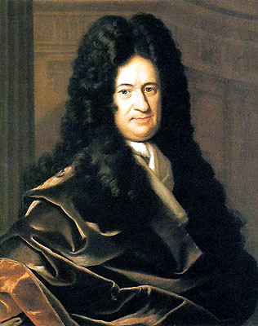
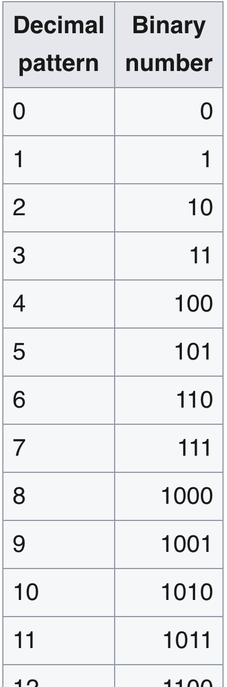
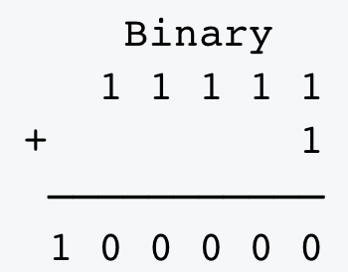
(1)Binary number representation
Gottfried Leibniz. 1679
addition
Notes:
Leibniz studied binary numbering in 1679; his work appears in his article Explication de l'Arithmétique Binaire (published in 1703) The full title of Leibniz's article is translated into English as the "Explanation of Binary Arithmetic, which uses only the characters 1 and 0, with some remarks on its usefulness, and on the light it throws on the ancient Chinese figures of Fu Xi".^{[18]} (1703). Leibniz's system uses 0 and 1, like the modern binary numeral system. An example of Leibniz's binary numeral system is as follows

Slide 31
(1)Arithmetic logic unit (ALU)
NOT
AND
11111
AND
AND
NOT
OR
AND
NOT
100000
NOT
AND
1
AND
OR
NOT
AND
OR
NOT
AND
AND
AND
AND
+

Slide 32
(1)Arithmetic logic unit (ALU)
Binary number
NOT
AND
AND
AND
OR
NOT
AND
NOT
100000
NOT
AND
Binary number
AND
OR
NOT
AND
OR
NOT
AND
AND
AND
AND
Subtraction,
Addition,
Multiplication, Division

Slide 33
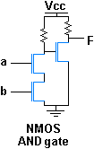
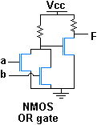
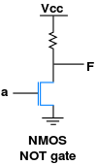
(2) The Logical Level
Input A | Input B | Output
1 | 1 | 1
1 | 0 | 0
0 | 1 | 0
0 | 0 | 0
Logical AND
Logical OR
Logical NOT
Input A | Input B | Output
1 | 1 | 1
1 | 0 | 1
0 | 1 | 1
0 | 0 | 0
Input A | Output
1 | 0
0 | 1
Notes:
We can combine these AND gates, OR gates, and NOT gates in a huge number of ways to transform the "true" and "false" signals into new "true" and "false" signals. So with this idea of manipulating truth and falsehood using logic gates, we can build circuits that can calculate whether things are true or false, just by setting the inputs of the gates and seeing what comes out of the other side, and checking whether the output is a high voltage (true) or a low voltage (false).
From these simple truth signals represented by voltages, we can now construct a basic system that can represent arithmetic. In our high/low voltage setup, we'll use the base-2 (binary) number system rather than our usual base-10 (decimal) system, since we only really have two possible "digits" (the true/false signals) available for us to use [1]. We'll pretend the "true" signals are actually the digit "1", and likewise, we'll pretend that the "false" signals are actually the digit "0". By combining the aforementioned AND, OR, and NOT gates in creative ways, we can create new devices that can perform addition, subtraction, and so on just by looking at the "digits" and combining/transforming them through sets of logic gates to get new "digits" that represent a "sum", a "difference", or whatever other "arithmetic" operation we want. (In fact, all you really need at this level is addition, since subtraction is just adding a negative number[2], multiplication is repeated addition[3], and division is repeated subtraction... sort of [4]).

Slide 34
(2) The Logical Level. Boolean arithmetic
Arithmetic Logic Unit

Slide 35
(1)The Logical Level. Boolean arithmetic
Arithmetic Logic Unit

Slide 36
(2) Logical Level. Boolean arithmetic
Addition
Subtraction
Multiplication
Division
Notes:
Remember this picture?
31 + 1

Slide 37
(2) Some memory
flip-flop or latch
is a circuit
that "remembers" its last input (0 or 1)
Notes:
Something to Remember Me By
We're not nearly up to the level of a CPU yet, though. Next, we need to introduce the idea of "state" and "memory". In other words, we need to build devices that can "remember" the results of prior truth/arithmetic calculations. It's not enough to just take the result of some calculation and see what it is right now, we must also be able to store that result so we can use it again at a later time.
We need a device that has "memory"— one whose "truth/falsehood" output value doesn't just depend on its inputs, but also on its entire history of inputs leading up to the present moment. This is the idea of a "latch" device. A "latch" is nothing more than a very particular arrangement of logic gates[1] that "remembers" its last input and continually outputs that value forever until you change it to something else. Using this property of latches, we can build circuits that not only do arithmetic/truth calculations, but can also "remember" those calculations and use the results for later calculations.
Now that we have introduced the dimension of time (since our calculations can now persist and change over time via memory devices), we'll need some way to synchronize all these calculations, so we can be sure that all the timed memory-based calculations give us the correct answer at the correct time. The way digital electronics do this is through a global voltage signal called a "clock". The clock signal[2] is just a voltage that oscillates between "high" and "low" voltages really fast, but at a very regular known interval. We can design our logic circuits to synchronize along this global clock signal and give us the "next stage" in our multi-step calculations each time the clock transitions from "low" to "high".
Now we can build more advanced "latch" devices that synchronize along this clock signal— we'll call them "flip-flops". Flip-flops are able to “remember” results (like latches), but only do so whenever the clock signal rises from low to high. (This allows us to synchronize each stage of a multi-step calculation with the clock signal.)
[1] Specifically, a latch is composed of multiple negating logic gates that feed their own outputs back into their inputs. It's weird thinking about that at first, but it actually works exactly as you would expect "memory" to work, and it's pretty clever.
[2] As a layman, you may have heard of this mystical "clock signal" before, in terms of a marketing number used to advertise how "fast" your CPU supposedly is. The "clock speed" of a CPU really just determines how fast this "global clock signal" flips back and forth between "high" and "low" voltage. (And before you ask— no, clock speed is not the only indicator of CPU performance, and it's not always a reliable way to determine how fast your CPU will run a given program).

Slide 38
(2) More memory
Register
Flip-flop
Flip-flop
Flip-flop
Flip-flop

Slide 39
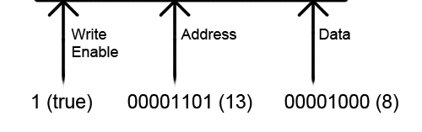
(2) Even more memory
RAM module
Register
Register
Register
Flip-flop
Flip-flop
Flip-flop
Flip-flop
Flip-flop
Flip-flop
…
Flip-flop
Flip-flop
Flip-flop
Flip-flop
Flip-flop
Flip-flop

Slide 40
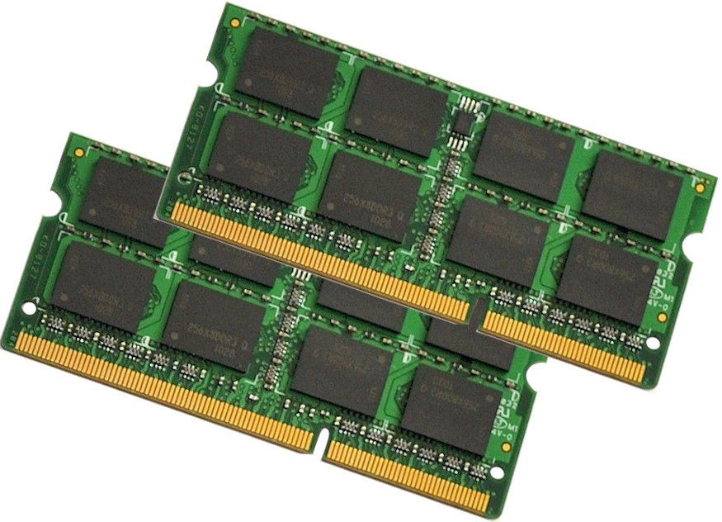
(2) RAM
Notes:
IN RAM we store data and commands to be executred.
We'll use a RAM module to hold the list of instructions that make up our "program
Each memory cell in RAM will hold a binary number that will represent an instruction for our "Turing Machine" to execute. For instance, address #0 will hold the first instruction, address #1 will hold the next instruction, and so on [4].

Slide 41
(3) Program counter (PC)
The role of the PC is to store the address of the current instruction in RAM that we want to execute
RAM module
Register
Register
Register
Flip-flop
Flip-flop
Flip-flop
Flip-flop
Flip-flop
Flip-flop
ALU
Flip-flop
Flip-flop
Flip-flop
Flip-flop
Flip-flop
Flip-flop
PC

Slide 42

(4)Write and read from memory in sync
Notes:
that we have introduced the dimension of time (since our calculations can now persist and change over time via memory devices), we'll need some way to synchronize all these calculations, so we can be sure that all the timed memory-based calculations give us the correct answer at the correct time. The way digital electronics do this is through a global voltage signal called a "clock". The clock signal[2] is just a voltage that oscillates between "high" and "low" voltages really fast, but at a very regular known interval. We can design our logic circuits to synchronize along this global clock signal and give us the "next stage" in our multi-step calculations each time the clock transitions from "low" to "high".
Clock - clocks

Slide 43
HARDWARE ready
RAM module
Register
Register
Register
Flip-flop
Flip-flop
Flip-flop
ALU
Flip-flop
Flip-flop
Flip-flop
Flip-flop
Flip-flop
Flip-flop
Flip-flop
Flip-flop
Flip-flop
PC

Slide 44
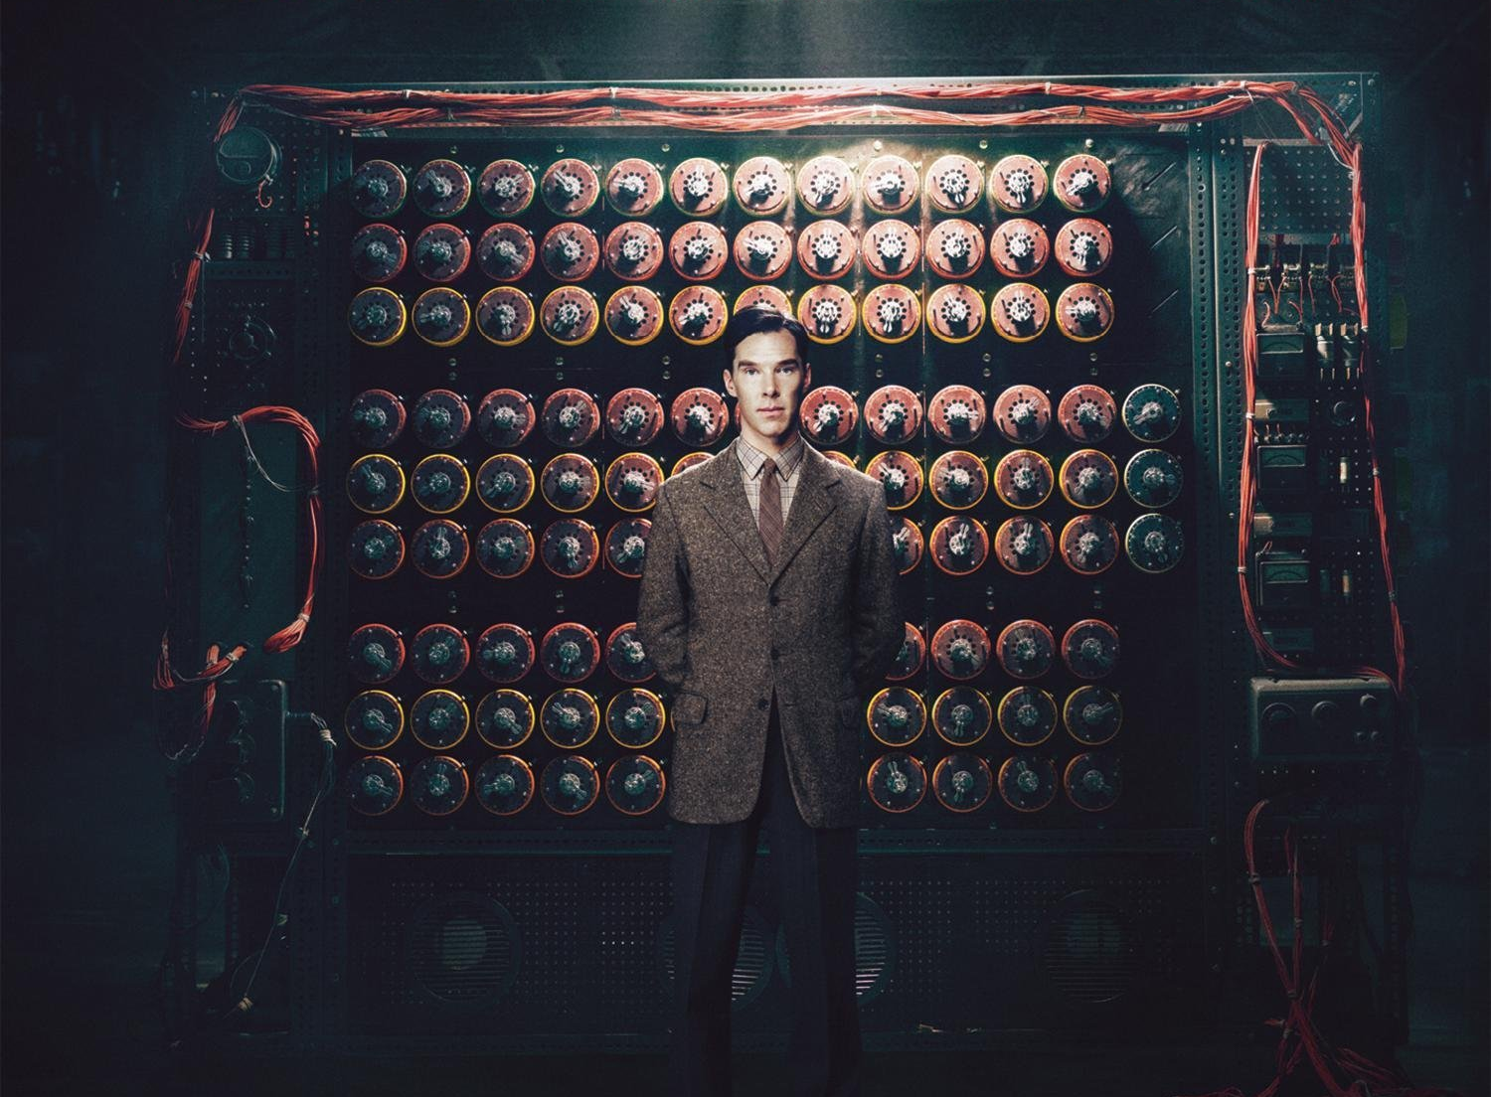
https://www.amazon.com/Imitation-Game-Alexandre-Desplat/dp/B00N2B1Z3U
Notes:
Otherwise known as the "Father of Modern Computer Science", AKA the really cool crazy dude from The Imitation Game

Slide 45
Turing machine
a device that could be reconfigured to perform any number of different tasks without having to change any of the internal circuitry
https://www.amazon.com/Imitation-Game-Alexandre-Desplat/dp/B00N2B1Z3U
Notes:
Otherwise known as the "Father of Modern Computer Science", AKA the really cool crazy dude from The Imitation Game
The great mathematician Alan Turing [1] once envisioned a device that could be reconfigured to perform any number of different tasks without having to change any of the internal circuitry— all you'd have to do is feed it different instructions, and it'll execute each instruction step by step. To change what the machine does, you just give it different instructions— no internal circuitry modification required. Let's build a register-transfer datapath that can act as such a "Turing Machine"[3] now.

Slide 46
Quiz 1!

Slide 47
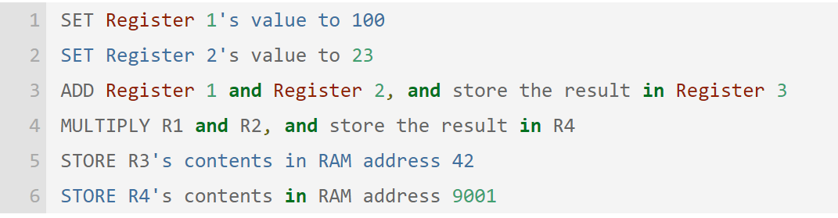
Assembler!
Notes:
now that we have a device that can execute programs based on binary numbers stored in RAM, how do we go about writing programs for this device? The simplest way would be to write your program in "human readable form", with each CPU instruction on each line, and then translate each instruction, by hand, into the instruction number sequences required. Then we'll just load those numbers into RAM, and voila! We have a machine-coded program that our machine can execute
Let's write a program for this CPU that does this boring translation work for us! After all, this is why we built the thing, no? It's our personal boring-work laborer that will happily do anything we ask it to.
Of course this first "translator" program itself needs to be translated by hand. But that's okay-- you only need to do the hand translation once. Once you have this translator program, you can use that translator program to translate other programs. Voila! You now have your very own "assembler". This "assembler" program is designed to do a 1-to-1 translation[3] of your "human readable" program (represented in RAM using ASCII) into the machine language binary number representation.

Slide 48
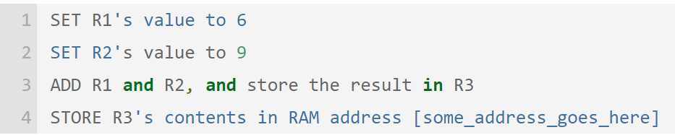
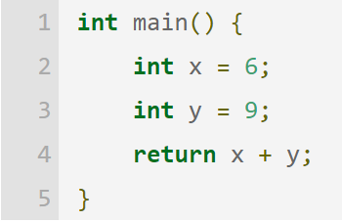
Low level languages
Assembler
Compiler
C++
C
Notes:
This is where "compilers" come in. A compiler is a program that turns a higher-level language, like C or C++, into assembly language. Once the assembly language translation is done, then we can use an assembler to translate the assembly into machine code, at which point the program will be ready to execute on the target CPU.

Slide 49
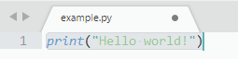
High Level languages!
Assembler
Python
Ruby
PHP
Perl
BASIC
Java
..
Compiler
Virtual machine, Interpreter

Slide 50
Quiz 2!

Slide 51
Jupiter notebook! Let’s put our hands to actually do something here
Integrated Development Environment (IDE)
web application
easy-to-use, interactive
show results in the same document with code
presentation: add description, plots, images & videos
Login to your own battlefield!
https://programming.ai.wu.ac.at/6088/notebooks/$STUDENTID

Slide 52

The only exercise
Make a program write “Hello, —your_name—”

Slide 53
Thanks for coming. Homework:
Describe some problem that you can possibly have/encounter that might be solved by programming.
Examples:
Trading bot for bitcoin (I want to get a hell a lot of money)
Alternative to google maps that only shows the map and the places with Kebab
A program that will automatically like all my friends Instagram posts, because I am lazy but want them remember of my existence.

Slide 54
How to submit?
Deadline, 14 of March 10pm (Tomorrow)
Algorithm to submit the homework:
Login to the course page https://learn.wu.ac.at/dotlrn/classes/pool/6088.18s
Find homework’s page
Write text
Click submit button

Slide 55
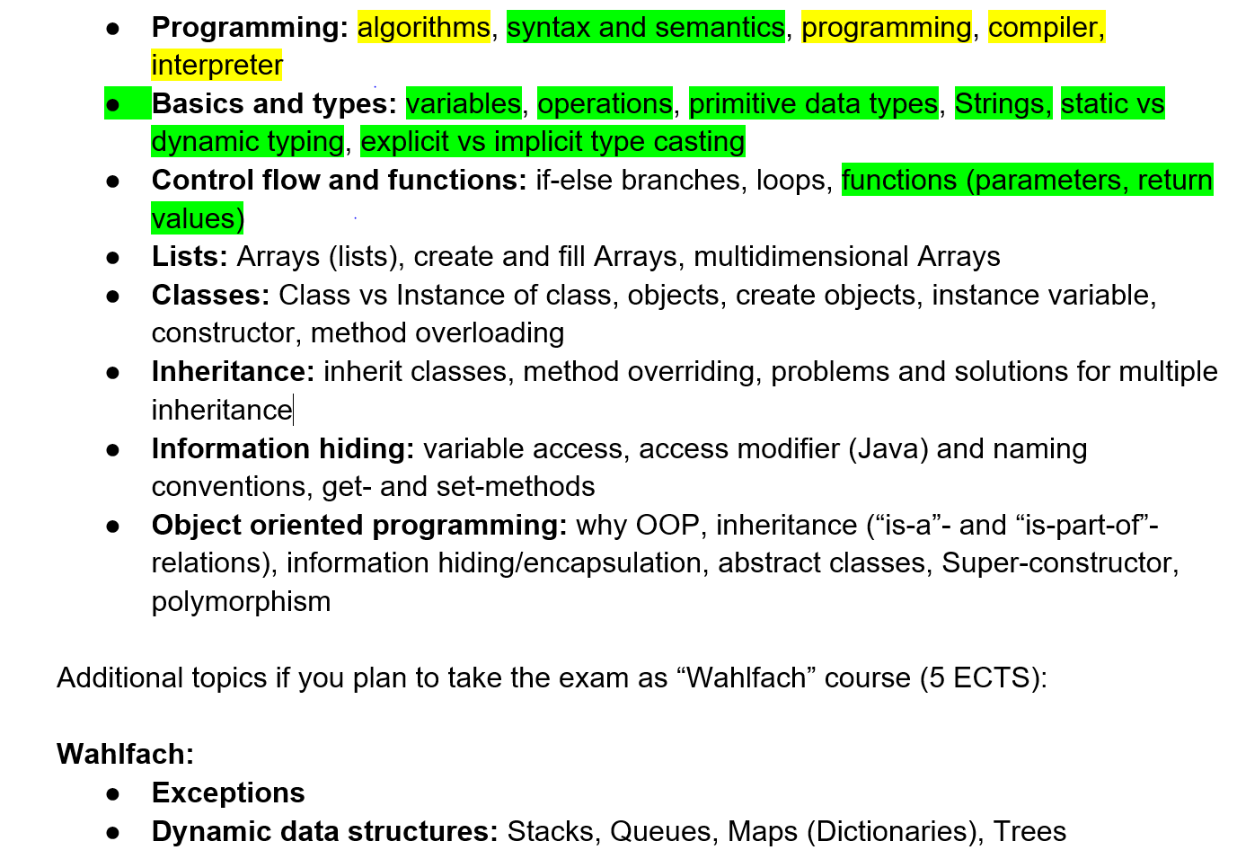
See you next time. 15 March

